Slide 1


Switch To Python
Module 4
Metaprogramming and Embedded Patterns
Authors: Anton Lysenko, Borys Vorona

Slide 2
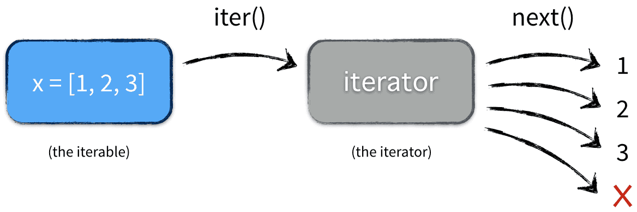
Iterators
Iterator in Python is simply an object that can be iterated upon. An object which will return data, one element at a time.
Python iterator object must implement two special methods, __iter__() and __next__(), collectively called the iterator protocol.
An object is called iterable if we can get an iterator from it. Most of built-in containers in Python like: list, tuple, string etc. are iterables.
Notes:
__iter__ method that is called on initialization of an iterator. This should return an object that has a next or __next__ (in Python 3) method.
next ( __next__ in Python 3) The iterator next method should return the next value for the iterable. When an iterator is used with a ‘for in’ loop, the for loop implicitly calls next() on the iterator object. This method should raise a StopIteration to signal the end of the iteration.

Slide 3
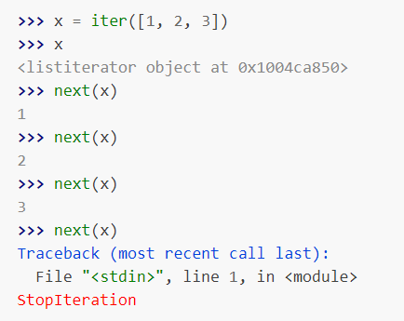
StopIteration
Lists, tuples, dictionaries, and sets are all iterable objects. They are iterable containers which you can get an iterator from.
All these objects have a iter() method which is used to get an iterator:
Each time we call the next method on the iterator gives us the next element. If there are no more elements, it raises a StopIteration.

Slide 4
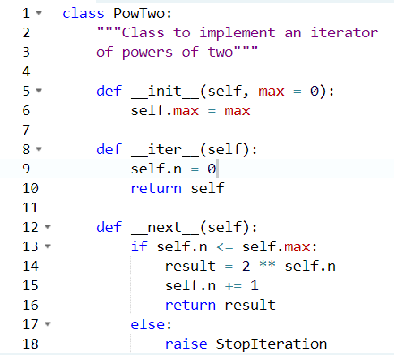
Custom iterator class
We just have to implement the methods __iter__() and __next__().
The __iter__() method returns the iterator object itself. If required, some initialization can be performed.
The __next__() method must return the next item in the sequence. On reaching the end, and in subsequent calls, it must raise StopIteration.
Notes:
we show an example that will give us next power of 2 in each iteration. Power exponent starts from zero up to a user set number.

Slide 5
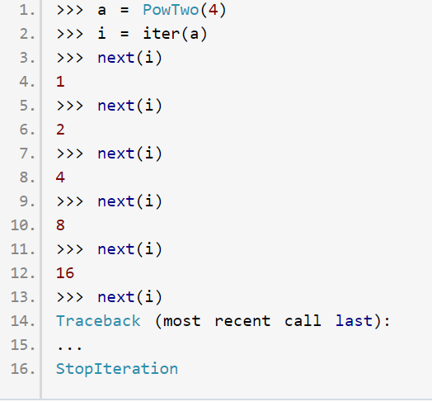
PowTwo class results
we show an example that will give us next power of 2 in each iteration. Power exponent starts from zero up to a user set number. On next calls than more 4 we will take StopIteration exception.

Slide 6
Work with files
The first thing you’ll need to do is use Python’s built-in open function to get a file object. The open function opens a file. It’s simple. When you use the open function, it returns something called a file object. File objects contain methods and attributes that can be used to collect information about the file you opened. They can also be used to manipulate said file.
file_object = open(“filename”, “mode”) where file_object is the variable to add the file object.

Slide 7
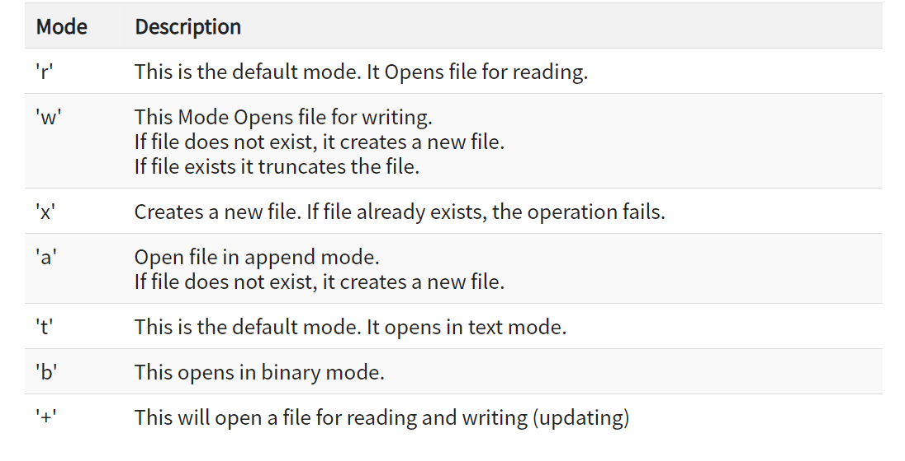
File modes in Python
Notes:
>

Slide 8


Read File
To open the file, use the built-in open() function.
The open() function returns a file object, which has a read() method for reading the content of the file:
By default the read() method returns the whole text, but you can also specify how many characters you want to return:
Notes:
>

Slide 9

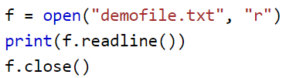
Read File
You can return one line by using the readline() method:
it returns first row from file demofile.txt
It is a good practice to always close the file when you are done with it.
Notes:
Readline returns empty row if file is end
You should always close your files, in some cases, due to buffering, changes made to a file may not show until you close the file.

Slide 10

Write File
To write to an existing file, you must add a parameter to the open() function:
"a" - Append - will append to the end of the file
"w" - Write - will overwrite any existing content
Create a file called "myfile.txt":
If file exists, you receive exception FileExists
Create a new file if it does not exist or rewrite exist file:

Slide 11

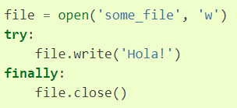
Context manager
Context managers allow you to allocate and release resources precisely when you want to. The most widely used example of context managers is the with statement.
The above code is equivalent to:
Notes:
Context manager guarantee close file or resource

Slide 12
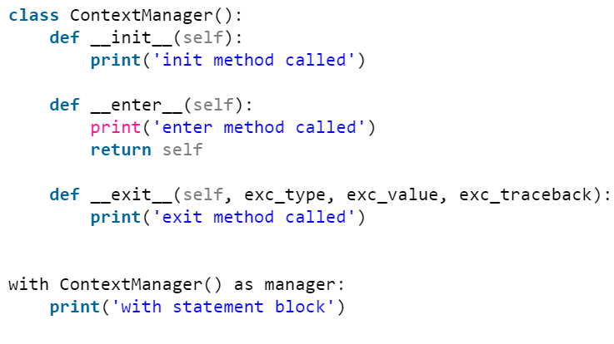
Magic methods enter exit
When creating context managers using classes, user need to ensure that the class has the methods: __enter__() and __exit__(). The __enter__() returns the resource that needs to be managed and the __exit__() does not return anything but performs the cleanup operations.
Output:
init method called
enter method called
with statement block
exit method called
Notes:
Также есть aenter, aexit для асинка

Slide 13
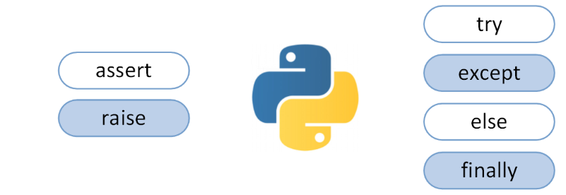
Exceptions
Python has many built-in exceptions which forces your program to output an error when something in it goes wrong.
Notes:
raise allows you to throw an exception at any time.
assert enables you to verify if a certain condition is met and throw an exception if it isn’t.

Slide 14
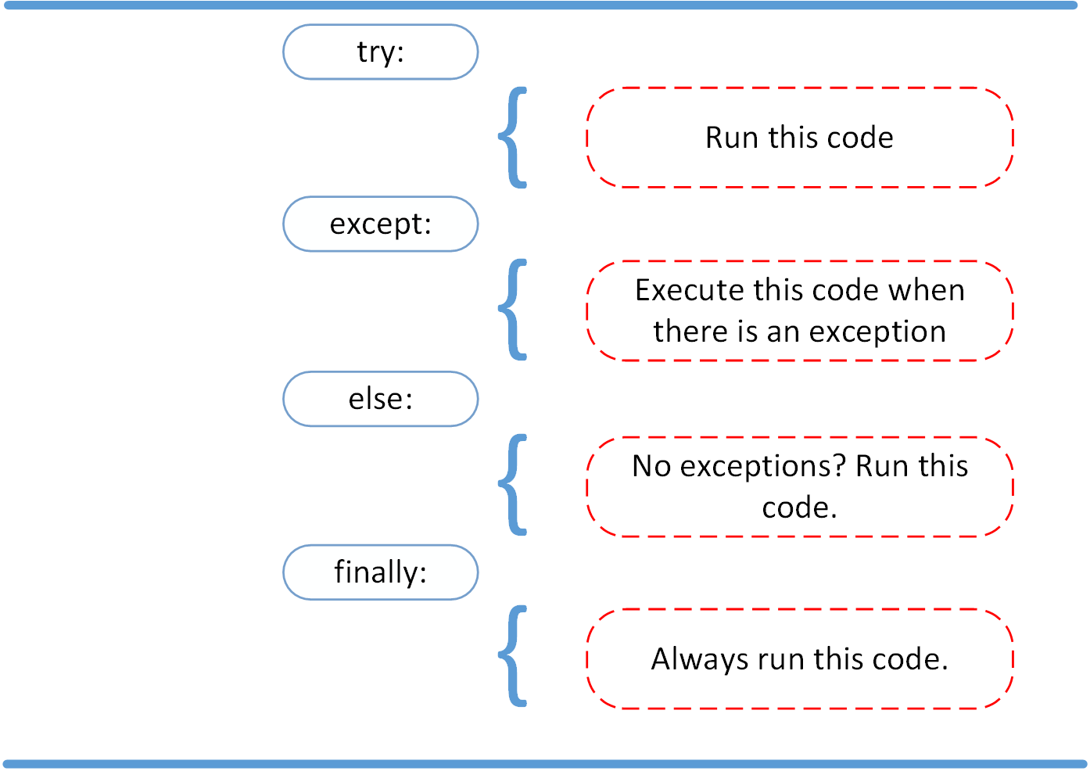
Exceptions
Pseudocode of the try-exception construction
Notes:
In the try clause, all statements are executed until an exception is encountered.
except is used to catch and handle the exception(s) that are encountered in the try clause.
else lets you code sections that should run only when no exceptions are encountered in the try clause.
finally enables you to execute sections of code that should always run, with or without any previously encountered exceptions.

Slide 15
Exceptions
Example of using try-except block
try:
linux_interaction()
except AssertionError as error:
print(error)
else:
try:
with open('file.log') as file:
read_data = file.read()
except FileNotFoundError as fnf_error:
print(fnf_error)
finally:
print('Cleaning up, irrespective of any exceptions.’)
def linux_interaction():
assert ('linux' in sys.platform), "Function can only run on Linux systems."
print('Doing something.')
Notes:
Если линукс то выведет: Doing something.
Далее проверка есть ли файл или нет (тут или есть или нет файла тогда: [Errno 2] No such file or directory: 'file.log')
Finally: Cleaning up, irrespective of any exceptions.
Если виндовс то: Function can only run on Linux systems.
Finally: Cleaning up, irrespective of any exceptions.

Slide 16
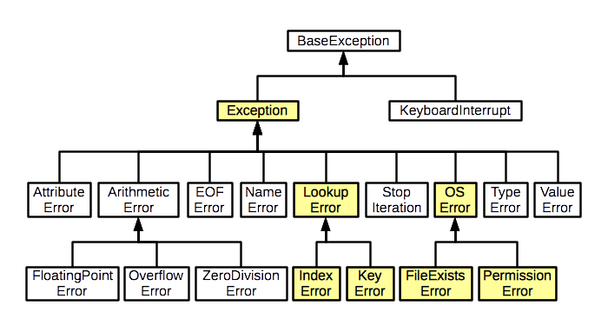
Hierarchy of Exceptions in Python

Slide 17
Metaclasses
The use of custom metaclasses is somewhat controversial, as suggested by the following quote from Tim Peters, the Python guru who authored the Zen of Python:
“Metaclasses are deeper magic than 99% of users should ever worry about. If you wonder whether you need them, you don’t (the people who actually need them know with certainty that they need them, and don’t need an explanation about why).”
— Tim Peters

Slide 18
What is a Metaclass in Python?
A class is an object, and just like any other object, it's an instance of something: a metaclass. The default metaclass in Python is type. Due to backwards compatibility, type is a bit confusing: it can also be used as a function that return the type of an object.
In object-oriented programming, a metaclass is a class whose instances are classes.
instance
Instance of
class
Instance of
metaclass

Slide 19
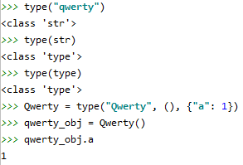
type in Python
There are two ways to call type() built-in:
type(object) – return type of object (isinstance() is recommended)
type(name, bases, dict) – return a new type object (class)
type() arguments:
<name> specifies the class name. This becomes the __name__ attribute of the class.
<bases> specifies a tuple of the base classes from which the class inherits. This becomes the __bases__ attribute of the class.
<dict> specifies a namespace dictionary containing definitions for the class body. This becomes the __dict__ attribute of the class.

Slide 20
Magic Methods
type metaclass defines the next key magic methods:
__prepare__(mcs, name, bases, **kwargs) – create and return the namespace data structure
__new__(mcs, name, bases, attrs, **kwargs) – create and return the instance of the class
__init__(cls, name, bases, attrs, **kwargs) – initialize and customize the instance of the class
__call__(cls, *args, **kwargs) – return whatever __new__ returned
The __prepare__ method will most often be implemented as a class method rather than an instance method because it is called before the metaclass instance (i.e. the class itself) is created. __prepare__ method is called before __new__ to declare what data structure will be used as attrs parameter. It can be any object but at last it must be a dict. It means super() call to type must use dict object. __new__ method is used to create the instance of class and return it. __init__ method initializes state of newly created class instance. __call__ method return whatever __new__ method returned.
Note the extra **kwargs - those are the extra keywords arguments you can pass in the class statement.

Slide 21
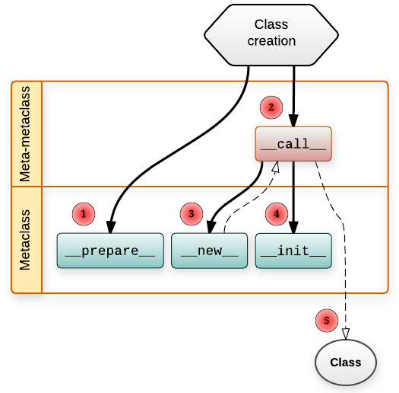
Class Creation Flow
Class creation is done using metaclass that was defined for this class (implicitly or explicitly). So, process of class creation can be expressed like this:
class C(B):
a = 1
b = 2
C = type(B)('C', (B,), {'a': 1, 'b': 2})
C = B.__class__('C', (B,), {'a': 1, 'b': 2})

Slide 22
Example of Custom Metaclass
class FinalMeta(type): @classmethod def __prepare__(mcs, name, bases, **kwargs): print('FinalMeta.__prepare__(mcs={}, name={}, bases={}, kwargs={})'.format(mcs, name, bases, kwargs)) return {} def __new__(mcs, name, bases, attr, **kwargs): print('FinalMeta.__new__(mcs={}, name={}, bases={}, attr={}, kwargs={})'.format(mcs, name, bases, attr, kwargs)) for base in bases: if isinstance(base, FinalMeta): raise RuntimeError("You cannot subclass a Final class") return super().__new__(mcs, name, bases, dict(attr)) def __init__(cls, name, bases, attrs, **kwargs): print('FinalMeta.__init__(mcs={}, name={}, bases={}, attrs={}, kwargs={})'.format(cls, name, bases, attrs, kwargs)) cls.member_names = attrs.member_names for key, value in kwargs.items(): setattr(cls, key, value) super().__init__(name, bases, attrs) def __call__(cls, *args, **kwargs): print('FinalMeta.__call__(cls={}, args={}, kwargs={})'.format(cls, args, kwargs)) return super().__call__(*args, **kwargs)

Slide 23
Decorators
Decorators are very powerful and useful tool in Python since it allows programmers to modify the behavior of function or class. Decorators allow us to wrap another function in order to extend the behavior of wrapped function, without permanently modifying it.
def a_function_requiring_decoration():
print("I am the function which needs some decoration to remove my foul smell")
a_function_requiring_decoration()
#outputs: "I am the function which needs some decoration to remove my foul smell"
a_function_requiring_decoration = a_new_decorator(a_function_requiring_decoration)
#now a_function_requiring_decoration is wrapped by wrapTheFunction()
a_function_requiring_decoration()
#outputs:I am doing some boring work before executing a_func()
# I am the function which needs some decoration to remove my foul smell
# I am doing some boring work after executing a_func()

Slide 24
Decorators
Decorators are very powerful and useful tool in Python since it allows programmers to modify the behavior of function or class. Decorators allow us to wrap another function in order to extend the behavior of wrapped function, without permanently modifying it.
def a_new_decorator(a_func):
def wrapTheFunction():
print("I am doing some boring work before executing a_func()")
a_func()
print("I am doing some boring work after executing a_func()")
return wrapTheFunction

Slide 25
Decorators.wraps
Now there is one problem with our code. If we run:
print(a_function_requiring_decoration.__name__)
# Output: wrapTheFunction
that’s not what we expected! Its name is “a_function_requiring_decoration”. Well, our function was replaced by wrapTheFunction. It overrode the name and docstring of our function. Luckily, Python provides us a simple function to solve this problem and that is functools.wraps
from functools import wraps
def a_new_decorator(a_func):
@wraps(a_func)
def wrapTheFunction():
print("I am doing some boring work before executing a_func()")
a_func()
print("I am doing some boring work after executing a_func()")
return wrapTheFunction

Slide 26
Decorators.wraps
@a_new_decorator
def a_function_requiring_decoration():
"""Hey yo! Decorate me!"""
print("I am the function which needs some decoration to "
"remove my foul smell")
print(a_function_requiring_decoration.__name__)
# Output: a_function_requiring_decoration
@wraps takes a function to be decorated and adds the functionality of copying over the function name, docstring, arguments list, etc. This allows us to access the pre-decorated function’s properties in the decorator.

Slide 27
Decorators with Arguments
from functools import wraps
def logit(logfile='out.log'):
def logging_decorator(func):
@wraps(func)
def wrapped_function(*args, **kwargs):
log_string = func.__name__ + " was called"
print(log_string)
# Open the logfile and append
with open(logfile, 'a') as opened_file:
# Now we log to the specified logfile
opened_file.write(log_string + '\n')
return wrapped_function
return logging_decorator
Notes:
This is because when you use the @my_decorator syntax, you are applying a wrapper function with a single function as a parameter Remember, everything in Python is an object, and this includes functions! With that in mind, we can write a function that returns a wrapper function.

Slide 28
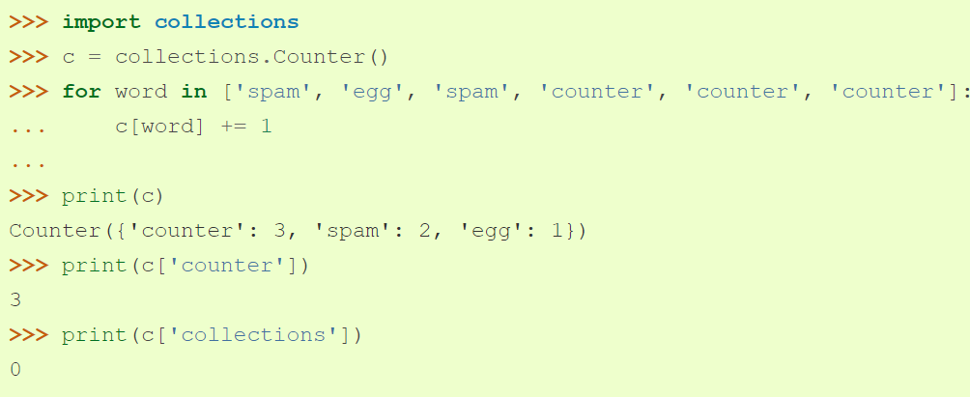
Collections
Counter - dict subclass for counting hashable objects.

Slide 29
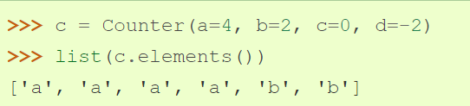

Collections.Counter
elements()
Return an iterator over elements repeating each as many times as its count. Elements are returned in arbitrary order. If an element’s count is less than one, elements() will ignore it.
most_common([n])
Return a list of the n most common elements and their counts from the most common to the least. If n is omitted or None, most_common() returns all elements in the counter. Elements with equal counts are ordered arbitrarily:a

Slide 30
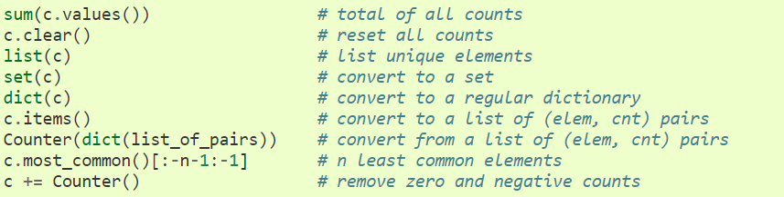
Collections.Counter
Common patterns for working with Counter objects:

Slide 31
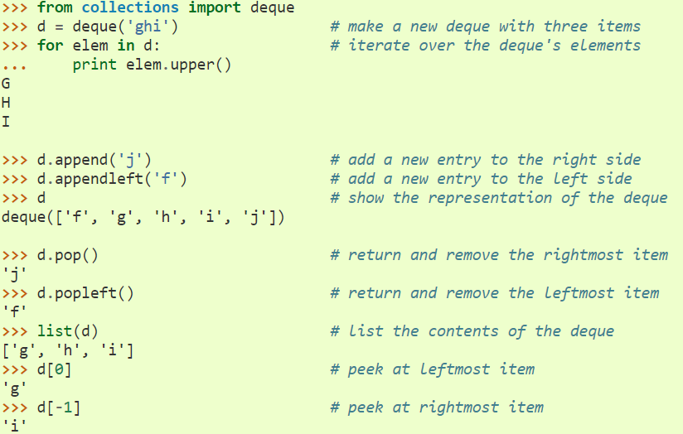
Collections.Deque
Deques are a generalization of stacks and queues (the name is pronounced “deck” and is short for “double-ended queue”). Deques support thread-safe, memory efficient appends and pops from either side of the deque with approximately the same O(1) performance in either direction.

Slide 32
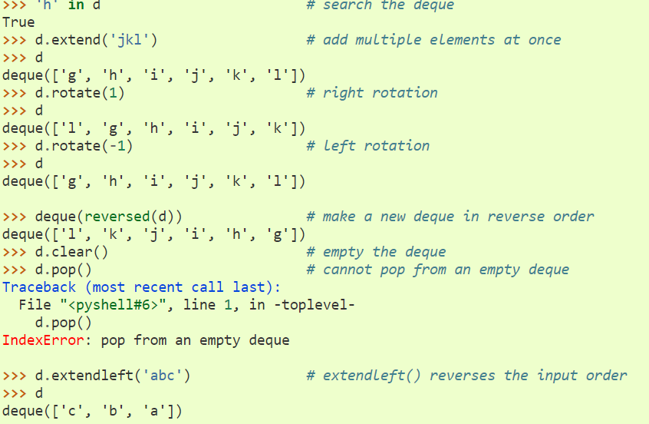
Collections.Deque

Slide 33
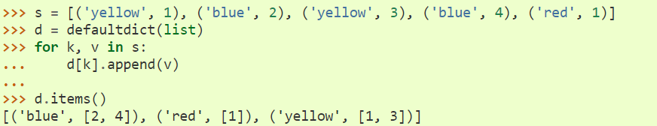
Collections.DefaultDict
Returns a new dictionary-like object. defaultdict is a subclass of the built-in dict class. It overrides one method and adds one writable instance variable. The remaining functionality is the same as for the dict class and is not documented here.
The first argument provides the initial value for the default_factory attribute; it defaults to None. All remaining arguments are treated the same as if they were passed to the dict constructor, including keyword arguments.

Slide 34
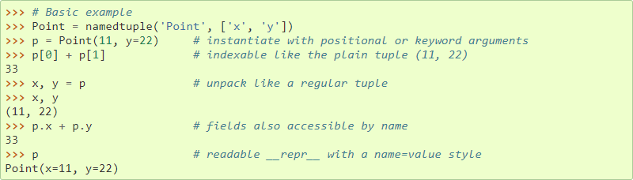
Collections.Namedtuple
Named tuples assign meaning to each position in a tuple and allow for more readable, self-documenting code. They can be used wherever regular tuples are used, and they add the ability to access fields by name instead of position index.

Slide 35
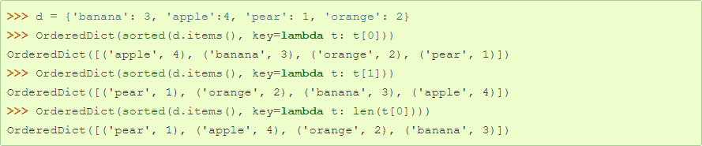
Collections.OrderedDict
Ordered dictionaries are just like regular dictionaries but have some extra capabilities relating to ordering operations. They have become less important now that the built-in dict class gained the ability to remember insertion order (this new behavior became guaranteed in Python 3.7).

Slide 36

THANK YOU!
Notes:
Вопросы?

